Slide 1
AREA OF 2D SHAPES

Slide 2
AREA OF A TRIANGLE
W
H
2
When finding the area of a triangle you multiply the width by height and divide that answer by 2

Slide 3
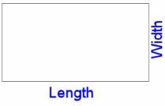
AREA OF A RECTANGLE
When finding the area of a rectangle you multiply the length by width

Slide 4
AREA OF A CIRCLE
$$π=3.14159$$
squared = times by its self
radius
When finding the area of a circle you multiply $π by r^{2}$

